Slide 1
Metering Engine
One enterprise platform for usage metering, reconciliation and monetization.
Reusable
Extensible
Audit-ready
Senior Leadership Review
Notes:
One platform for usage metering and monetization. Built once, reusable across sources and billing providers.

Slide 2

Current Architecture & Advantages
Source Systems
Event Stream
Event Processor
Aggregator
Monetization
Gateway · ASDE
Kafka topic
Validate · store raw
Classify · aggregate
Billing file → ACO
Decoupled by design
Trustworthy billing
Built for scale
Each stage scales and fails independently
No data loss, no duplicate charges
Designed for billions of events per month
New sources added without touching billing
Every event validated and traceable
Horizontal scale, no re-architecture
Raw data retained as the source of truth
Rejections captured, never silently dropped
Low-cost storage tiering built in
Dashboards generated by simply querying S3 storage
Advantage: one metering pipeline replaces per-application billing builds.
Notes:
Events flow from source systems through Kafka, are stored raw, aggregated and classified, then delivered to the billing provider. Every stage is decoupled.

Slide 3
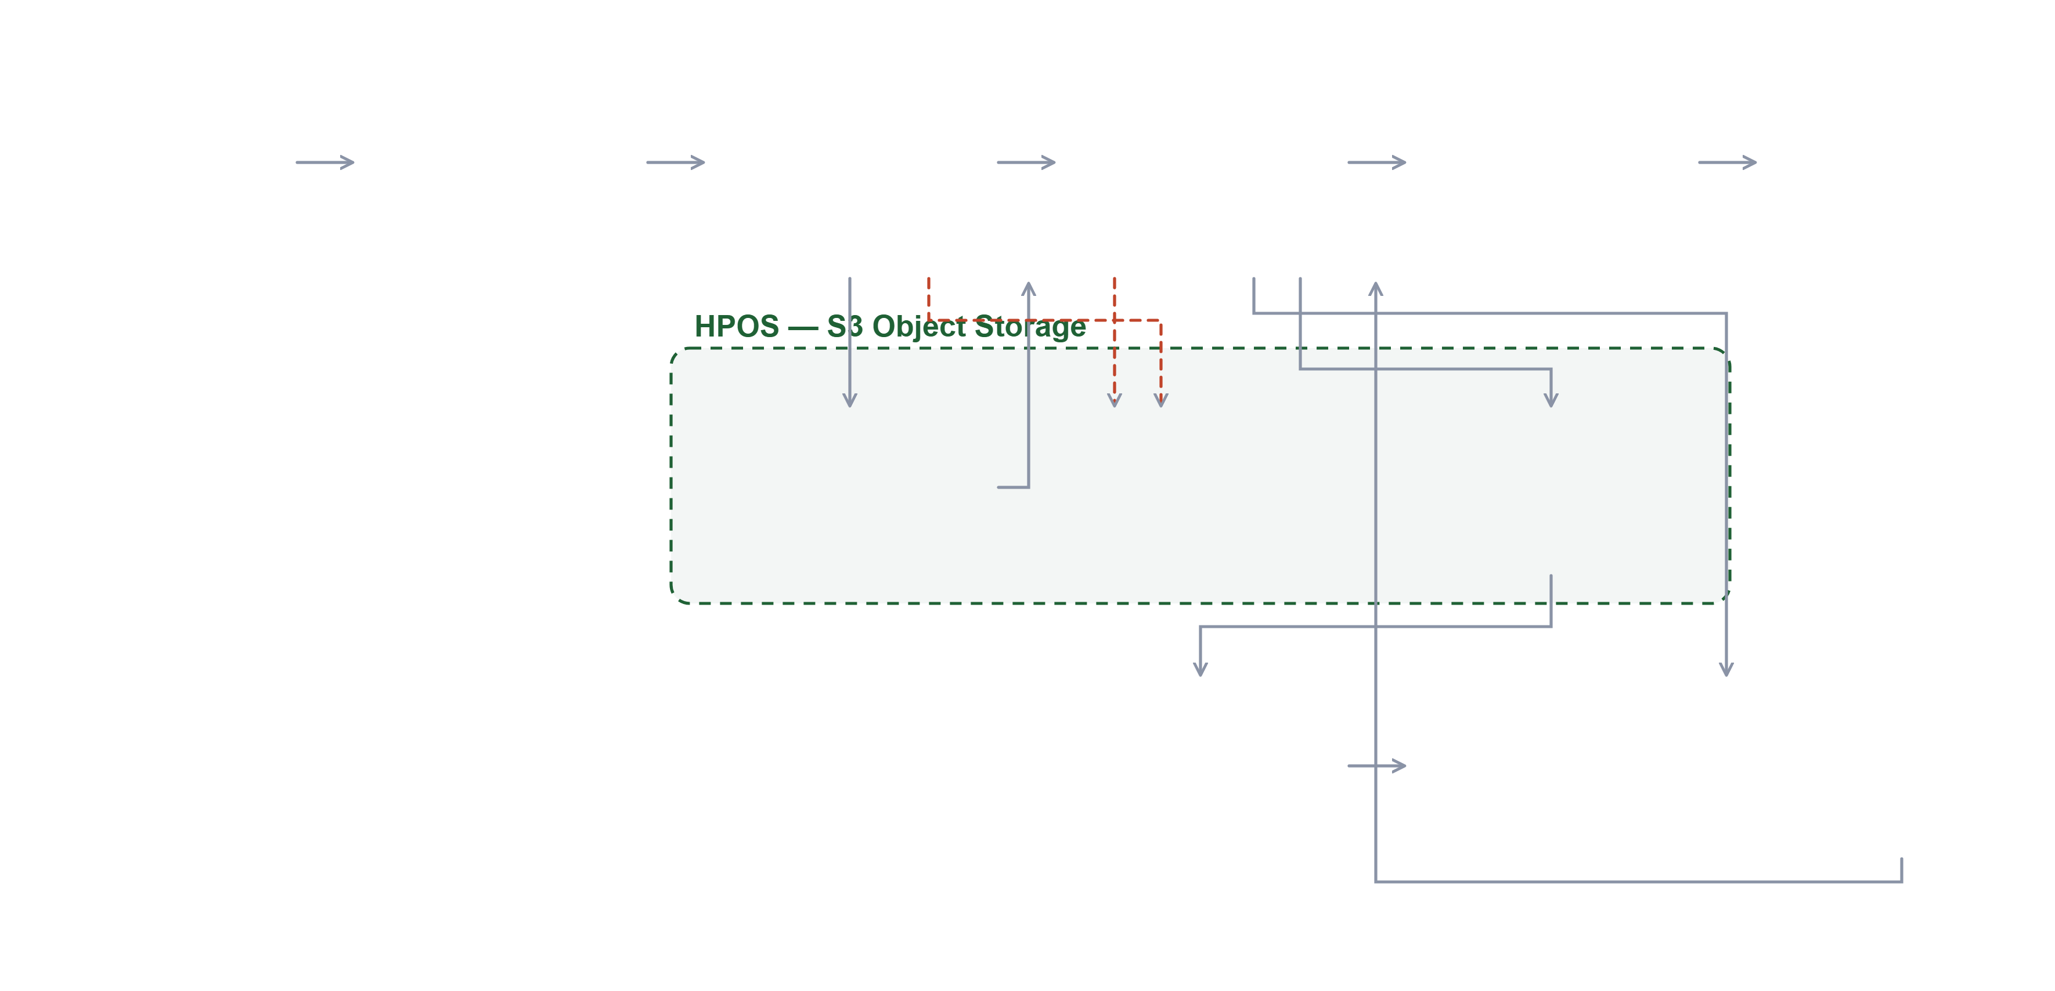
Detailed Architecture
Main flow
Exception path
Core component
HPOS S3 storage
Source Systems
Kafka Topic
Event Processor
Aggregator
Monetization
ACO / RPM Billing System
Partitioned · durable buffer
Billing rules · classify
Price · map · deliver
Gateway · ASDE · future apps
Validate & de-duplicate
Receives billing file
RAW_EVENTS
Exception Events
Parquet Files
Source of truth
Billable · non-billable
Rejected · failed
Query Engine on S3
Dashboards & Reports
MongoDB
Daily & monthly aggregates
SQL over Parquet
Tableau-style BI
Audit & Reconciliation
Control totals · full event lifecycle · applies across every stage above
Notes:
The full pipeline. Event Processor and Aggregator write into HPOS S3 object storage - raw events, classified parquet and exception events all live there. Monetization delivers the billing file to the ACO billing system. Parquet in S3 is queried directly by a query engine to power dashboards and Tableau-style reports.

Slide 4
Design Guarantees
Four guarantees are built into the pipeline, not added afterwards — this is why the billing output can be defended.
Zero data loss
No duplicate billing
An event is confirmed in storage before the pipeline moves on. Nothing is dropped silently.
Every event is de-duplicated individually, so a retry never becomes a second charge.
Predictable at scale
Resilient by design
Batched, stateless processing keeps memory bounded regardless of volume or backlog.
If a downstream system is unavailable, processing pauses and resumes automatically — without loss.
Notes:
The four engineering guarantees behind the architecture, in business terms. These are what make the billing numbers defensible.

Slide 5
Reusability & Extensibility
One engine, many use cases. Any application that needs to bill a third party or aggregator plugs into the same pipeline.
STRATEGIC VALUE
Onboard by configuration, not code. New sources, clusters and pricing rules are config changes.
One Platform Multiple Sources Multiple Billing Providers
Shared capabilities for free. Validation, audit, reconciliation and reporting come with the platform.
Avoids duplicate build. Each new billing need reuses the pipeline instead of funding a new one.
Faster time to market
Lower cost per use case
Consistent controls
Lower risk
Weeks to onboard, not a new programme.
One platform cost, shared across apps.
Same audit and reconciliation everywhere.
Proven pipeline instead of new code paths.
Notes:
This is the core leadership message. Built once, reused everywhere. New source systems and billing providers onboard by configuration, not by new projects.

Slide 6
Reusability in Practice
A new billing use case inherits the whole pipeline. These capabilities do not have to be built, tested or audited again.
Inherited Capabilities
Configured, Not Coded
Extension Points
Event ingestion & buffering
New source system
Billing provider adapters
Validation & de-duplication
New aggregator or recipient
Additional validation rules
Aggregation & classification
New billing cluster
New aggregation dimensions
Pricing rule engine
Pricing & rate changes
Alternate pricing models
Billing file generation
Billing schedule
Reporting & BI extensions
Audit & reconciliation
Export format & delivery
Chargeback / showback
Every new use case starts at 80% complete.
Notes:
What reuse looks like concretely. A new billing use case reuses eleven capabilities it would otherwise have to build. Onboarding is configuration, and the same controls apply everywhere.

Slide 7


Billing Provider Integration Model
Consolidated usage is delivered to the ACO / RPM billing system today, and to future billing providers through adapters.
ACO / RPM
today
Consolidated Usage from Metering Engine
Billing Provider Adapter Layer
Future Provider
via adapter
Provider Configuration
Provider Independence
Operational Governance
Export format
Adapter isolates provider rules
Audit file generation
Delivery mechanism
Billing changes do not impact sources
Delivery tracking
Aggregation level
Multiple providers can coexist
Retry and failure handling
Billing schedule & control totals
Future migration is lower risk
Reconciliation support
Notes:
An adapter layer means the billing provider is a plug-in choice, not an architectural commitment. ACO today, RPM or others later.

Slide 8
Reconciliation & Reporting Advantages
Source-to-Metering
Metering-to-Billing
Reporting & Governance
Events published vs received
Processed usage vs billing export
Usage reporting by source, app and provider
Missing event detection
Provider acknowledgement tracking
Audit-ready event lifecycle
Duplicate event detection
Billing exception visibility
Dispute investigation support
Source-level control totals
Replay-backed correction process
Chargeback / showback readiness
Advantage: billing outputs become transparent, traceable and reconcilable end to end.
Notes:
Billing you can defend. Every number traceable from source event to billing line.

Slide 9
Query & Analytics Capability
Usage data is stored as Parquet on object storage, so it can be queried directly with SQL — no data movement, no separate warehouse.
Self-service answers
Faster dispute resolution
Business and finance teams query usage directly by aggregator, product, cluster or period.
Trace any billed amount back to the underlying events in minutes.
No duplicate data platform
Revenue insight
Columnar storage is the analytics layer — avoids a second copy and its cost.
Spot usage trends, under-billing and growth opportunities across aggregators.
The billing system is also the usage intelligence system.
Notes:
Because raw and aggregated data sit in Parquet on object storage, it can be queried directly with SQL. No extra warehouse, no data movement.

Slide 10
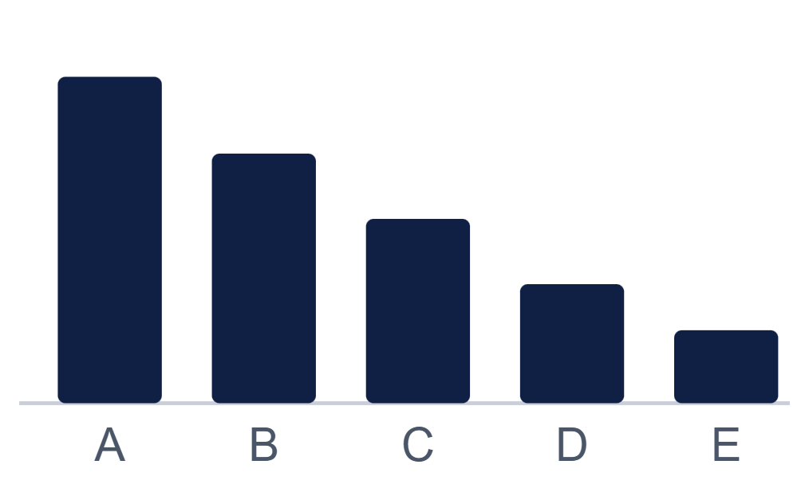
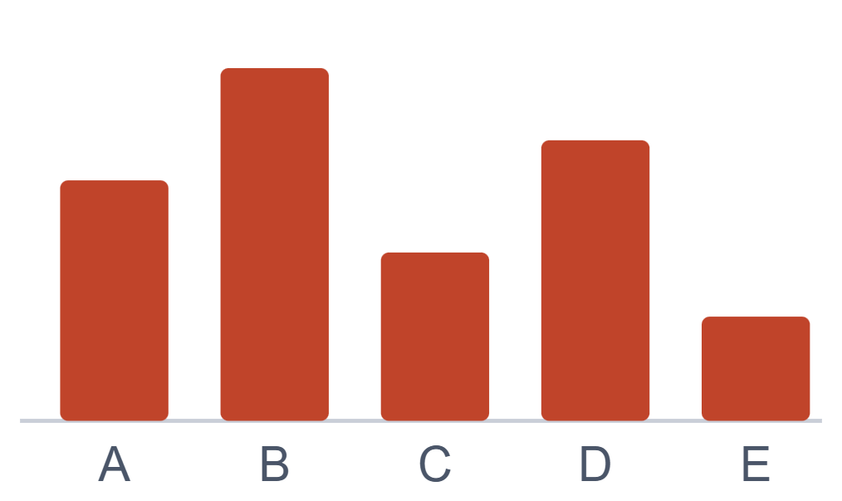
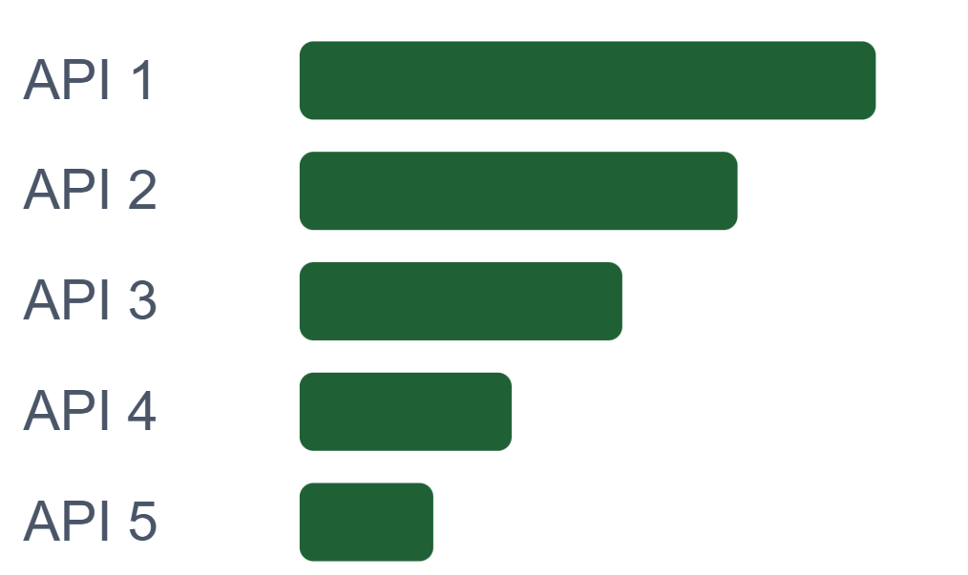
Reporting & Insights
Querying the Parquet layer directly answers the questions leadership actually asks. Illustrative views below.
Event Volume by Aggregator
Revenue by Aggregator
Revenue by API
Billable event counts per aggregator
Which aggregator and recipient drive revenue
Highest-earning APIs and products
Illustrative views · generated directly from the S3 Parquet layer
Notes:
Illustrative reporting the query layer enables: volume by aggregator, revenue by aggregator and recipient, and revenue by API. These are sample shapes, not actual figures.

Slide 11

Future Scope & Enterprise Value
A staged path from today's billing pipeline to an enterprise monetization platform.
Horizon 1 · Near term
Horizon 2 · Mid term
Horizon 3 · Long term
Onboard additional enterprise source systems
New billing providers via adapters
Single enterprise monetization platform
Quick invoice adjustments — credits, re-rates and corrections applied on demand
Usage-based and tiered pricing models
Centralised usage governance & policy
Chargeback / showback for internal consumers
Forecasting and revenue insight
Exception dashboards for operations
Self-service analytics on the Parquet layer
Partner-facing usage transparency
Automated reconciliation reporting
Quick Invoice Adjustments
STRATEGIC VALUE
Because every billed line traces back to its source events, corrections can be applied and re-issued quickly — credits, re-rates and disputed items resolved without a manual reconstruction exercise.
Build once. Bill anything. Govern centrally.
Notes:
Three horizons. Near term we broaden sources and add quick invoice adjustments. Mid term we add providers, pricing models and self-service analytics. Long term the Metering Engine becomes the enterprise monetization and usage-governance foundation.

Slide 12
Why This Matters
Revenue Assurance
Cost Avoidance
Audit Confidence
Every billable event captured
Future billing needs reuse this platform
Traceable event lifecycle
No revenue leakage
No separate builds to fund
Control totals for reconciliation
No double billing
One platform cost across applications
Dispute investigation support
Validated and reconciled end to end
Dashboards without a new data platform
Audit-ready by design
Build once. Bill anything. Govern centrally.
Notes:
Close with the leadership summary: what we have, what it saves, what we need.

